Slide 1
Overfitting and Underfitting

Slide 2
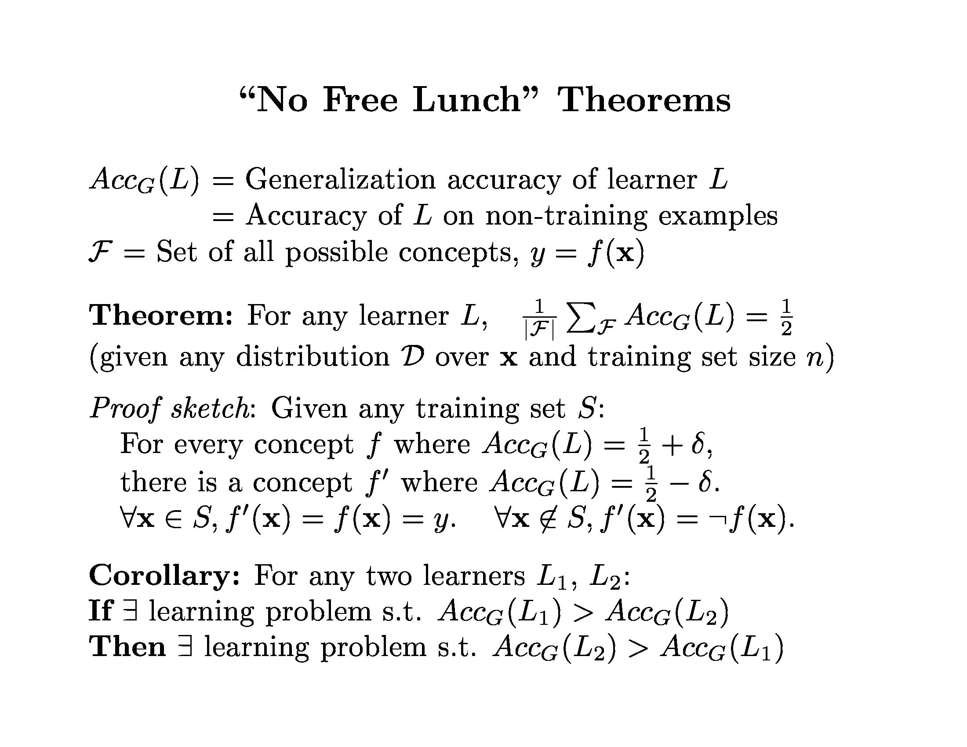
Don’t expect your favorite learner to always be best
Try different approaches and compare

Slide 3
Bias and Variance
Bias – error caused because the model can not represent the concept
Variance – error caused because the learning algorithm overreacts to small changes (noise) in the training data
TotalLoss = Bias + Variance (+ noise)

Slide 4
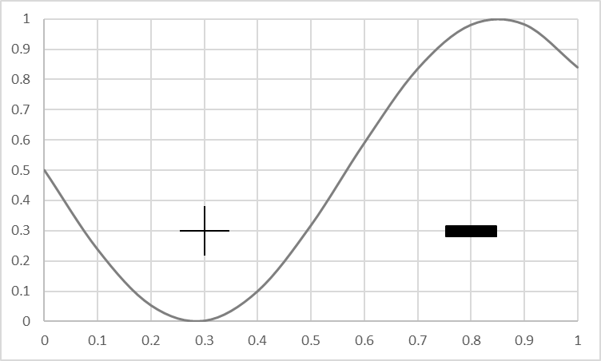
Visualizing Bias
Goal: produce a model that matches this concept
True Concept

Slide 5
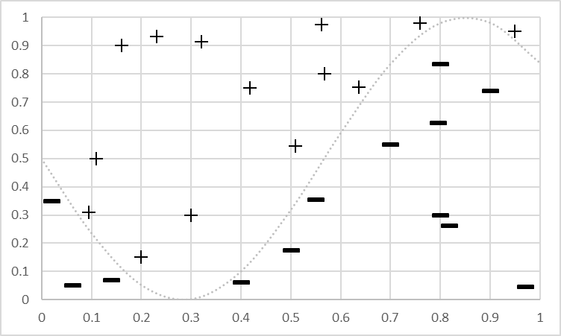
Visualizing Bias
Goal: produce a model that matches this concept
Training Data for the concept
Training Data

Slide 6
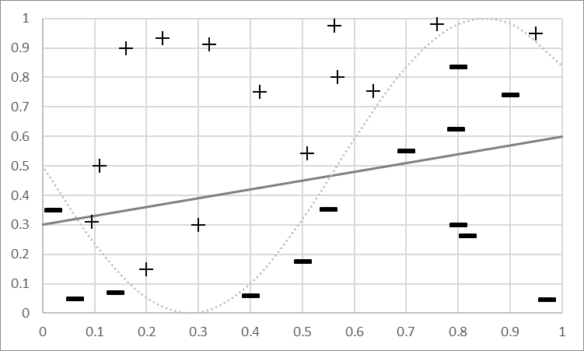
Visualizing Bias
Bias Mistakes
Goal: produce a model that matches this concept
Training Data for concept
Bias: Can’t represent it…
Model Predicts +
Model Predicts -
Fit a Linear Model

Slide 7
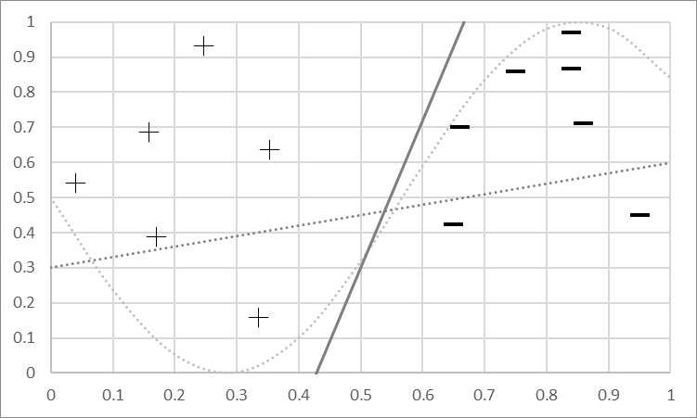
Visualizing Variance
Different Bias Mistakes
Goal: produce a model that matches this concept
New data, new model
Model Predicts +
Model Predicts -
Fit a Linear Model

Slide 8
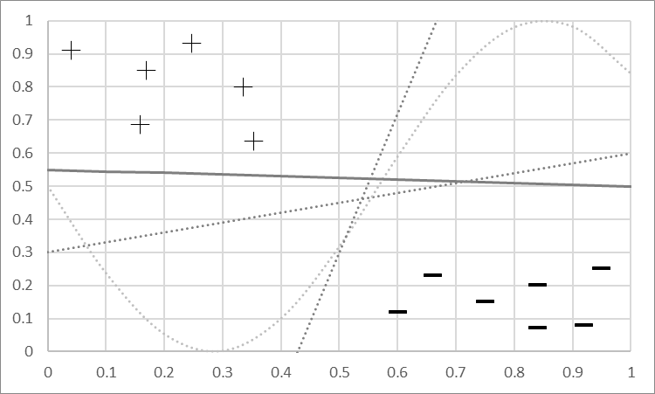
Visualizing Variance
Mistakes will vary
Goal: produce a model that matches this concept
New data, new model
New data, new model…
Variance: Sensitivity to changes & noise
Model Predicts +
Model Predicts -
Fit a Linear Model

Slide 9
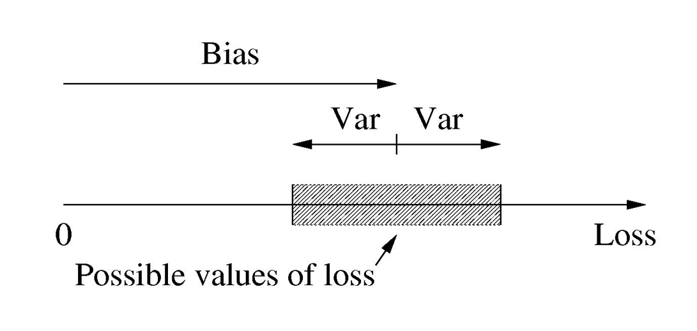
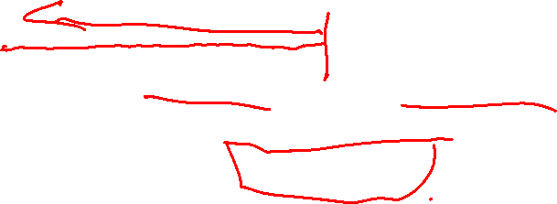
Another way to think about Bias & Variance

Slide 10
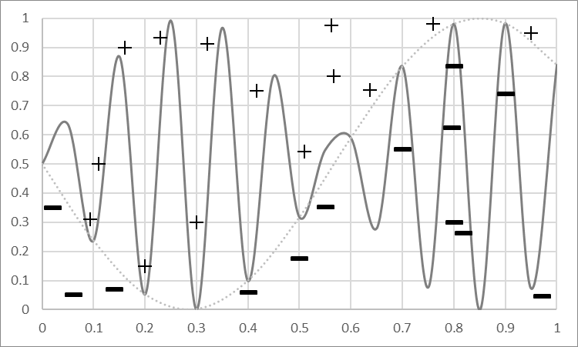
Bias and Variance: More Powerful Model
Model
Predicts +
Powerful Models can represent complex concepts
No Mistakes!
Model Predicts -

Slide 11
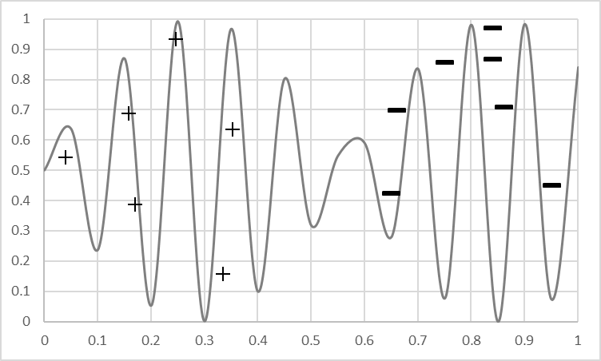
Bias and Variance: More Powerful Model
Model
Predicts +
But get more data…
Not good!
Model Predicts -

Slide 12
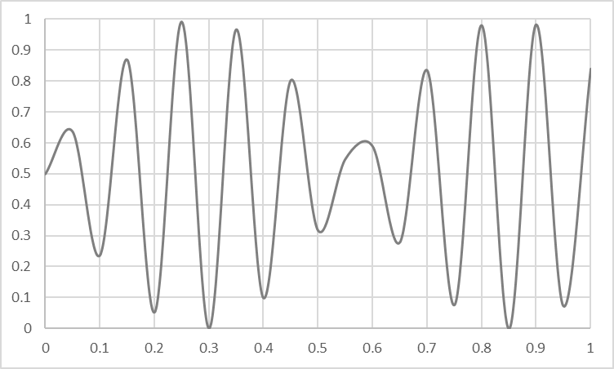
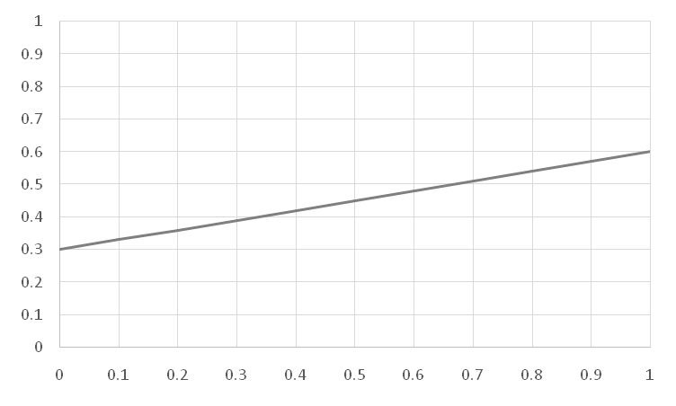
Overfitting vs Underfitting
Overfitting
Underfitting
Fitting the data too well
  Features are noisy / uncorrelated to concept
  Modeling process very sensitive (powerful)
  Too much search
Learning too little of the true concept
  Features don’t capture concept
  Too much bias in model
  Too little search to fit model

Slide 13
The Effect of Noise

Slide 14
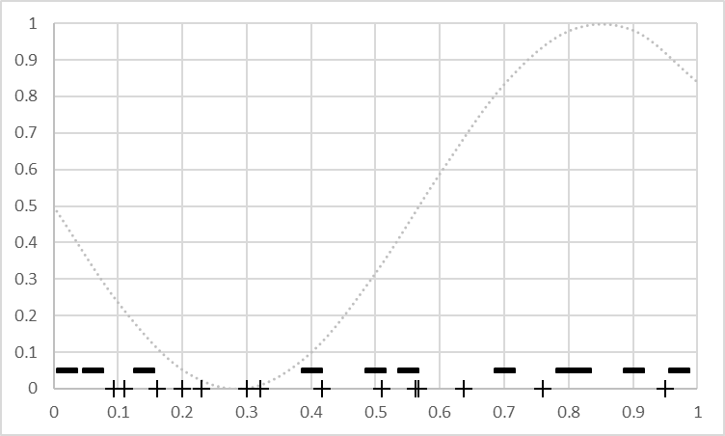

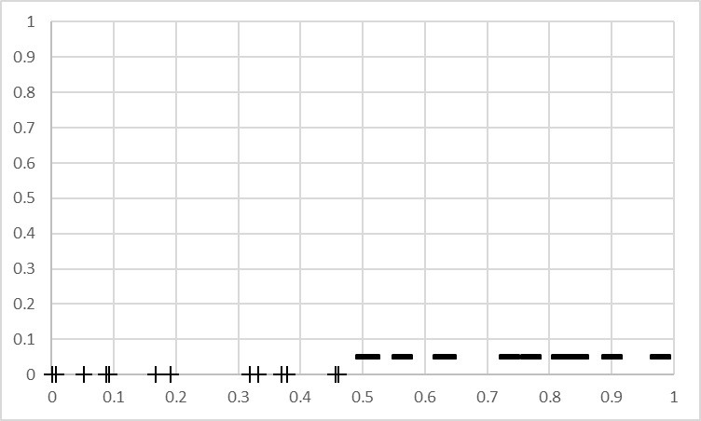

The Effect of Features
Not much info
Won’t learn well
Powerful -> high variance
Captures concept
Simple model -> low bias
Powerful -> low variance

Slide 15
The Power of a Model Building Process
Weaker Modeling Process
( higher bias )
More Powerful Modeling Process
(higher variance)
Simple Model (e.g. linear)
Fixed sized Model (e.g. fixed # weights)
Small Feature Set (e.g. top 10 tokens)
Constrained Search (e.g. few iterations of gradient descent)
Complex Model (e.g. high order polynomial)
Scalable Model (e.g. decision tree)
Large Feature Set (e.g. every token in data)
Unconstrained Search (e.g. exhaustive search)

Slide 16
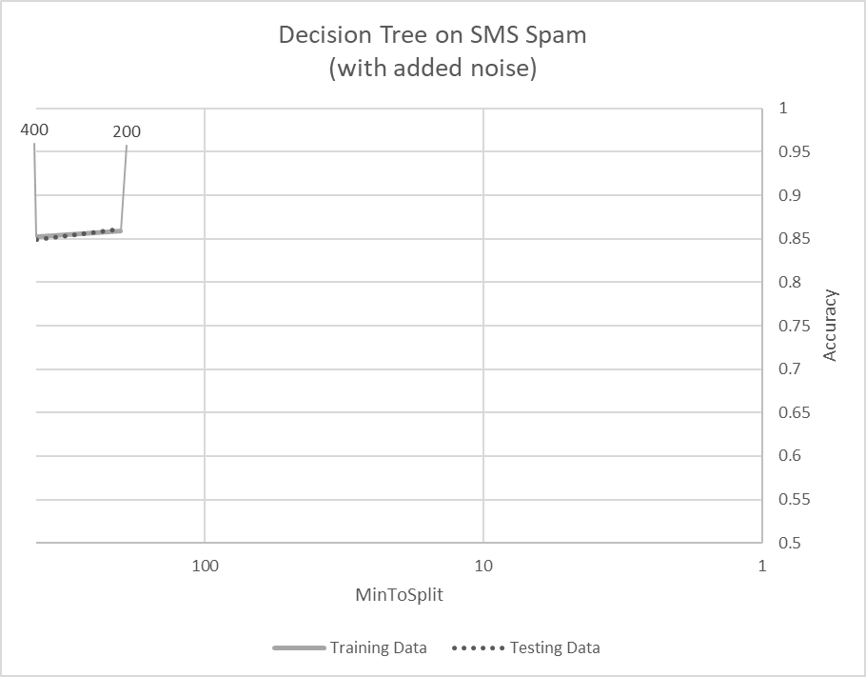
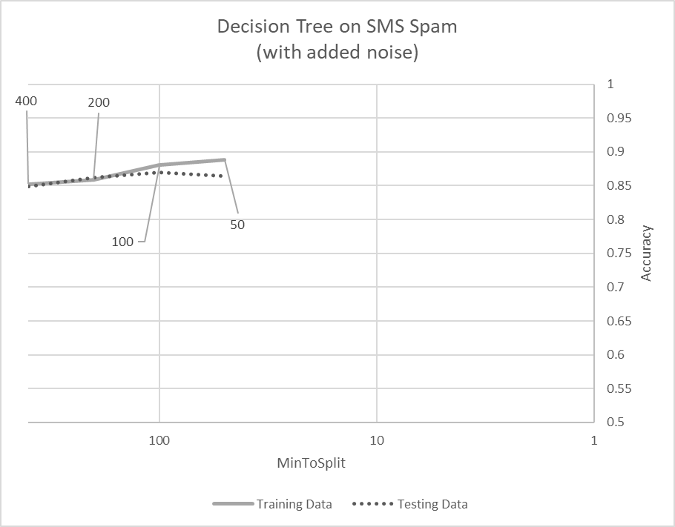
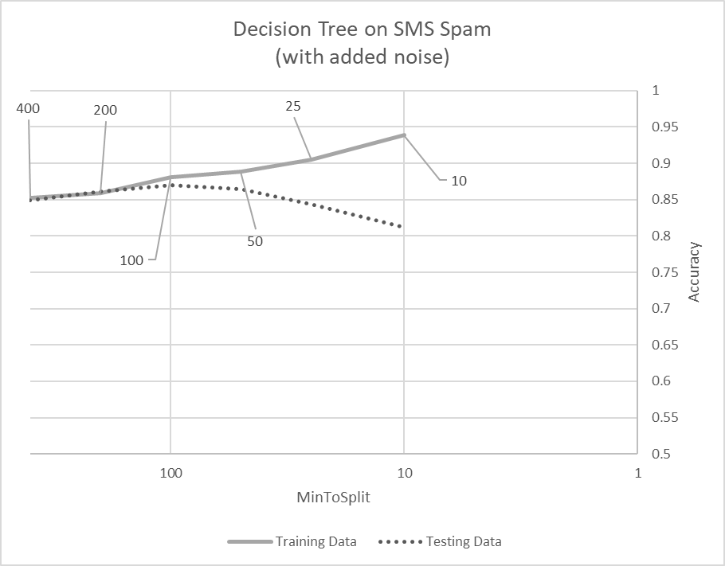
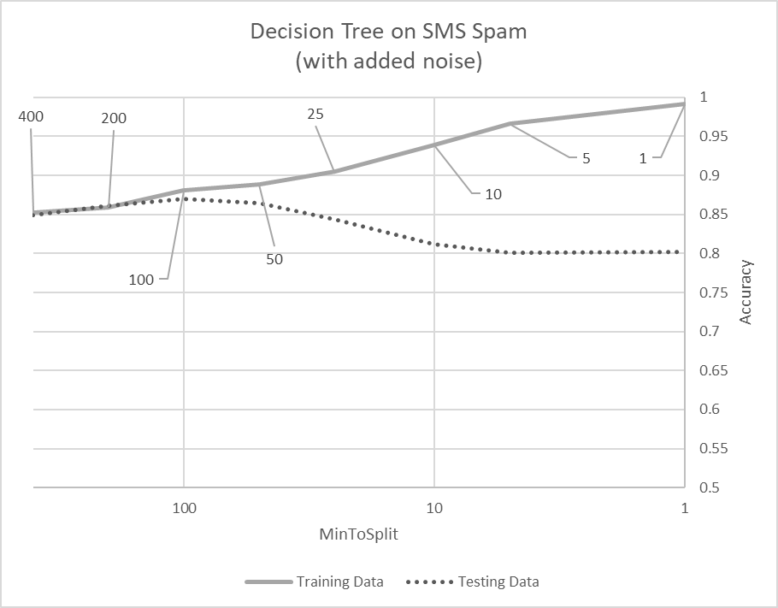
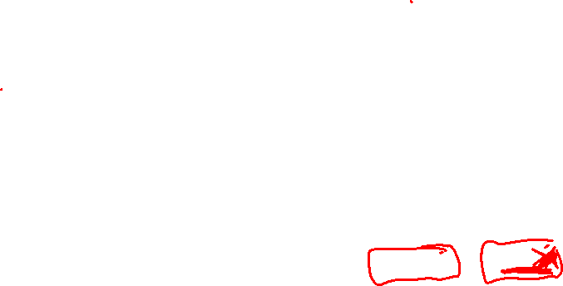
Example of Under/Over-fitting

Slide 17
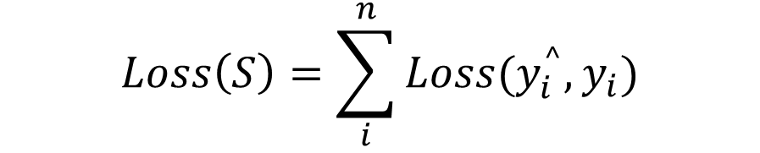

Ways to Control Decision Tree Learning
Increase minToSplit
Increase minGainToSplit
Limit total number of Nodes
Penalize complexity

Slide 18
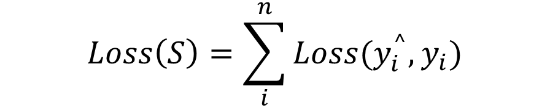
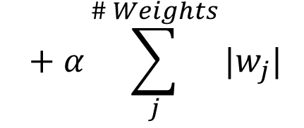
Ways to Control Logistic Regression
Adjust Step Size
Adjust Iterations / stopping criteria of Gradient Descent
Regularization

Slide 19
Modeling to Balance Under & Overfitting
Data
Learning Algorithms
Feature Sets
Complexity of Concept
Search and Computation
Parameter sweeps!

Slide 20
Parameter Sweep
# optimize first parameter
for p in [ setting_certain_to_underfit, …, setting_certain_to_overfit]:
  # do cross validation to estimate accuracy
  # find the setting that balances overfitting & underfitting
# optimize second parameter
  # etc…
# examine the parameters that seem best and adjust whatever you can…

Slide 21
Types of Parameter Sweeps
Optimize one parameter at a time
  Optimize one, update, move on
  Iterate a few times
Gradient descent on meta-parameters
  Start somewhere ‘reasonable’
  Computationally calculate gradient wrt change in parameters
Grid
  Try every combination of every parameter
Quick vs Full runs
  Expensive parameter sweep on ‘small’ sample of data (e.g. grid)
  A bit of iteration on full data to refine
Intuition & Experience
  Learn your tools
  Learn your problem

Slide 22
Summary of Overfitting and Underfitting
Bias / Variance tradeoff a primary challenge in machine learning
Internalize: More powerful modeling is not always better
Learn to identify overfitting and underfitting
Tuning parameters & interpreting output correctly is key

